Slide 1

Secure Cloud Foundry Deployments

Slide 2
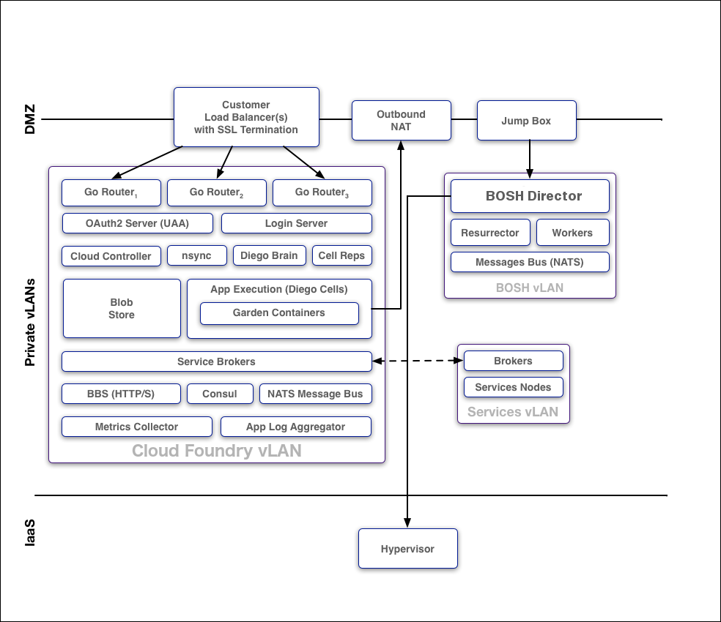
General Architecture
Notes:
goal:
single platform for all devices
Increase quality and reduce the amount of stabilization
reduce planning.
PaaS is good fit for Project automatization
tests should be small.

Slide 3
Protocols
From the outside to Cloud Foundry
HTTPS
Inside the boundaries of the Cloud Foundry Deployment
NATS
HTTP
SSL/TLS
Notes:
goal:
single platform for all devices
Increase quality and reduce the amount of stabilization
reduce planning.
PaaS is good fit for Project automatization
tests should be small.

Slide 4
BOSH
Access control
Deploy BOSH in a non-public accessible subnet
Access the BOSH director thru a Jumpbox or VPN
Notes:
goal:
single platform for all devices
Increase quality and reduce the amount of stabilization
reduce planning.
PaaS is good fit for Project automatization
tests should be small.

Slide 5
Isolation Segments
Isolate resources for applications
Provides dedicated resources to deploy applications
Isolation segments are defined by orgs and spaces
Examples:
Regulatory restrictions (isolation of concerns)
Dedicate exclusive resources to high priority apps
Offer different hosting tiers
Identify the resources in BOSH with the ‘placement_tag’ property.
Notes:
goal:
single platform for all devices
Increase quality and reduce the amount of stabilization
reduce planning.
PaaS is good fit for Project automatization
tests should be small.

Slide 6
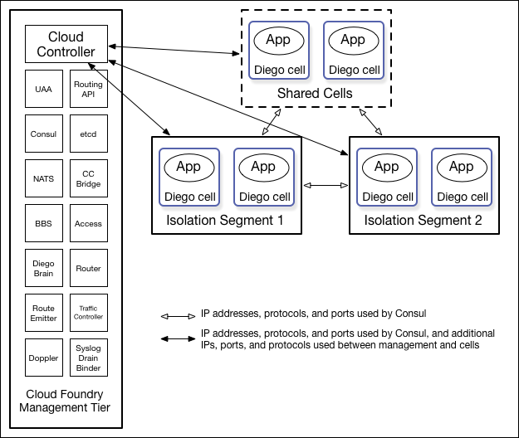
Isolation Segments
Notes:
goal:
single platform for all devices
Increase quality and reduce the amount of stabilization
reduce planning.
PaaS is good fit for Project automatization
tests should be small.

Slide 7
Services SSO
UAA allows to
authenticate with third-party service dashboards using their Cloud Foundry credentials
provides a streamlined experience without having to login repeatedly
Enabling:
properties: uaa: clients: cc-service-dashboards: secret: cc-broker-secret scope: openid,cloud_controller_service_permissions.read authorities: clients.read,clients.write,clients.admin authorized-grant-types: authorization_code,client_credentials
Notes:
goal:
single platform for all devices
Increase quality and reduce the amount of stabilization
reduce planning.
PaaS is good fit for Project automatization
tests should be small.

Slide 8
General Security Recommendations
Configure UAA clients and users using a BOSH manifest.
Deploy within a VLAN that limits network traffic to individual VMs.
Enable HTTPS for applications and SSL database connections to protect sensitive data transmitted to and from applications
Ensure that the Jumpbox is secure, along with the load balancer and NAT VMs.
Store SSH keys securely to prevent disclosure, and promptly replace lost or compromised keys.
Use Cloud Foundry’s RBAC model to restrict your users’ access to only what is necessary to complete their tasks.
Use a strong passphrase for both your Cloud Foundry user account and SSH keys.

Slide 9
PKI management with CredHub
Component designed for centralized credential management
Provides:
Securing data for storage
Authentication
Authorization
Access and change logging
Data typing
Credential generation
Credential metadata
Credential versioning

Slide 10
CredHub credential types
Value
JSON
Password
Certificate (root CA, certificate, private key)
SSH Public Key
RSA (public and private keys)

Slide 11
CredHub HSMs
Hardware that provides cryptoprocessing facilities to store and manage cryptographic information
Example: AWS CloudHSM
CredHub provides modules to access AWS CloudHSM and Luna SafeNet HSM

Slide 12
Container to Container Networking
CtoCN allows you to:
Create policies for communication between app instances
Provide a unique IP address to each app container
Provides direct IP reachability between app instances
Policies specify:
source app
destination app
protocol
port
Supports:
UDP
TCP
Policies for multiple ports
Policies apply immediately without having to restart the app

Slide 13
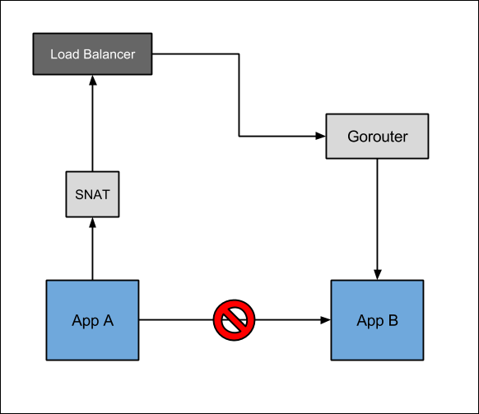
Without CtoCN
Traffic from App A routes out
The requests comes back in through the Gorouter
App B does not know the real source of the traffic
Performance is less than optimal and the protocols are restricted

Slide 14
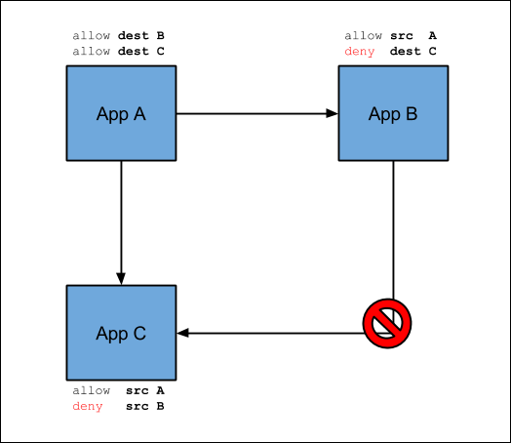
With CtoCN
Operator creates two policies:
Allow traffic from App A to App B
Allow traffic from App A to App C
If traffic and its direction is not explicitly allowed, it is denied:
App B cannot send traffic to App C.
Communication goes directly between application containers, performance is increased as well as the possibility of using several protocols and ports

Slide 15
CtoCN vs ASGs
 | ASGs | Container-to-Container Networking Policies
Policy granularity | From a space to an IP address range | From a source app to a destination app
Scope | For a space, org, or deployment | For app to app only
Traffic direction | Outbound control | Policies apply for incoming packets from other app instances
Source app | Is not known | Is identified because of direct addressability
Policies take affect | After app restart | Immediately

Slide 16
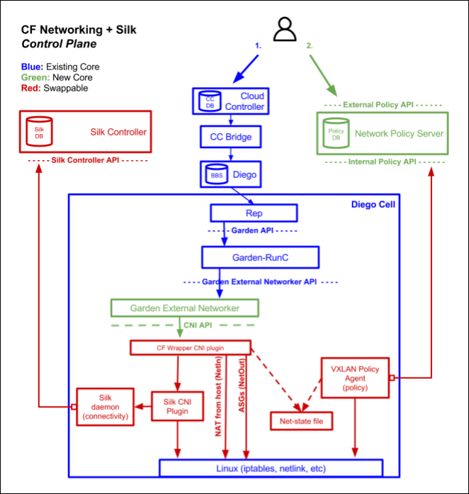
CtoCN Architecture

Slide 17
Core components of CtoCN
Part | Function
Cloud Foundry Command Line Interface (CF CLI) plugin | A plugin that you download to control network access policies between apps.
Policy Server | A central management node that does the following: Maintains a database of policies for traffic between apps. The CF CLI plugin calls an API to create or update a record in the policy database whenever you create or remove a policy. Exposes a JSON REST API used by the CF CLI plugin
Garden External Networker | A Garden-runC add-on deployed to every Diego cell that does the following: Invokes the CNI plugin component to set up the network for each app Forwards ports to support incoming connections from the Gorouter, TCP Router, and Diego SSH Proxy. This keeps apps externally reachable. Installs outbound whitelist rules to support Application Security Groups (ASGs).

Slide 18
Swappable components of CtoCN
Part | Function
Silk CNI plugin | A plugin that provides IP address management and network connectivity to app instances as follows: Uses a shared VXLAN overlay network to assign each container a unique IP address Installs network interface in container using the Silk VXLAN backend. This is a shared, flat L3 network.
VXLAN Policy Agent | Enforces network policy for traffic between apps as follows: Discovers desired network policies from the Policy Server Internal API Updates iptables rules on the Diego cell to allow whitelisted inbound traffic Tags outbound traffic with the unique identifier of the source app using the VXLAN Group-Based Policy (GBP) header

